Slide 1
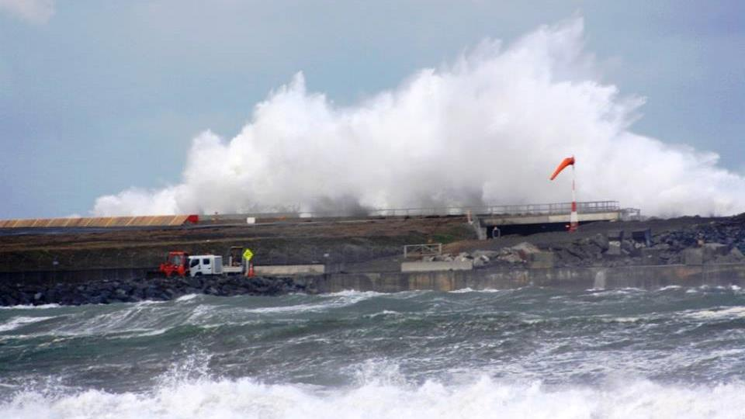
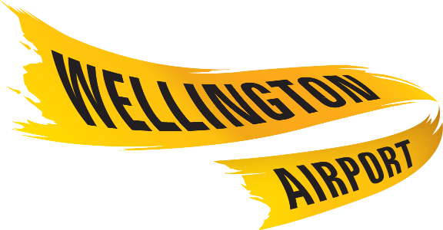

Marine Defences Renewal

Slide 2
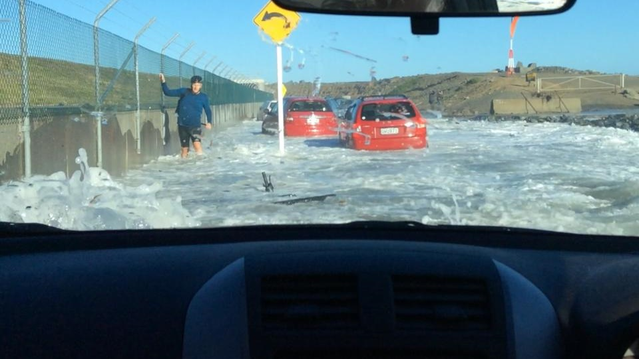
Topics
Background and history
Maintenance regime
Proposed works
Next Steps

Slide 3
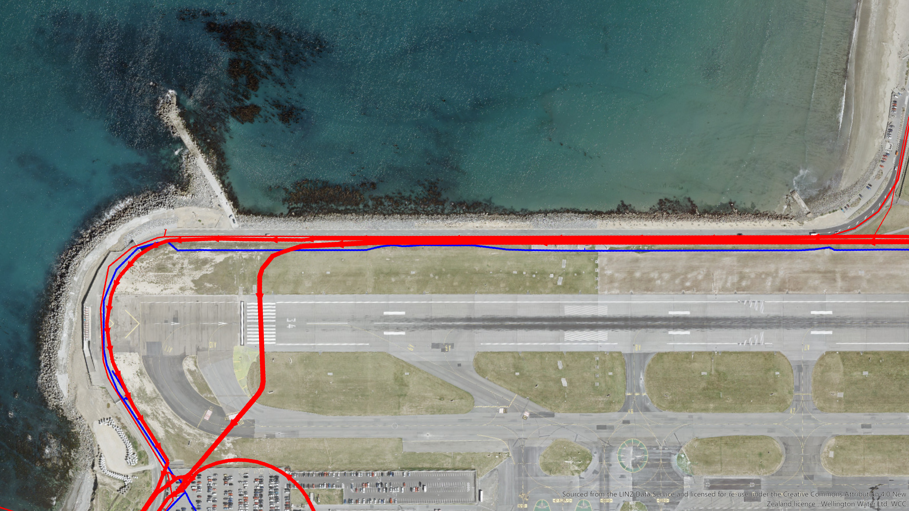
Marine Defences
Breakwater
Sewerage to Moa Point WWTP & sludge back to Southern Landfill
Western Seawall
Southern Seawall
Moa Point Road
Potable Water supply
Eastern Eroding area

Slide 4
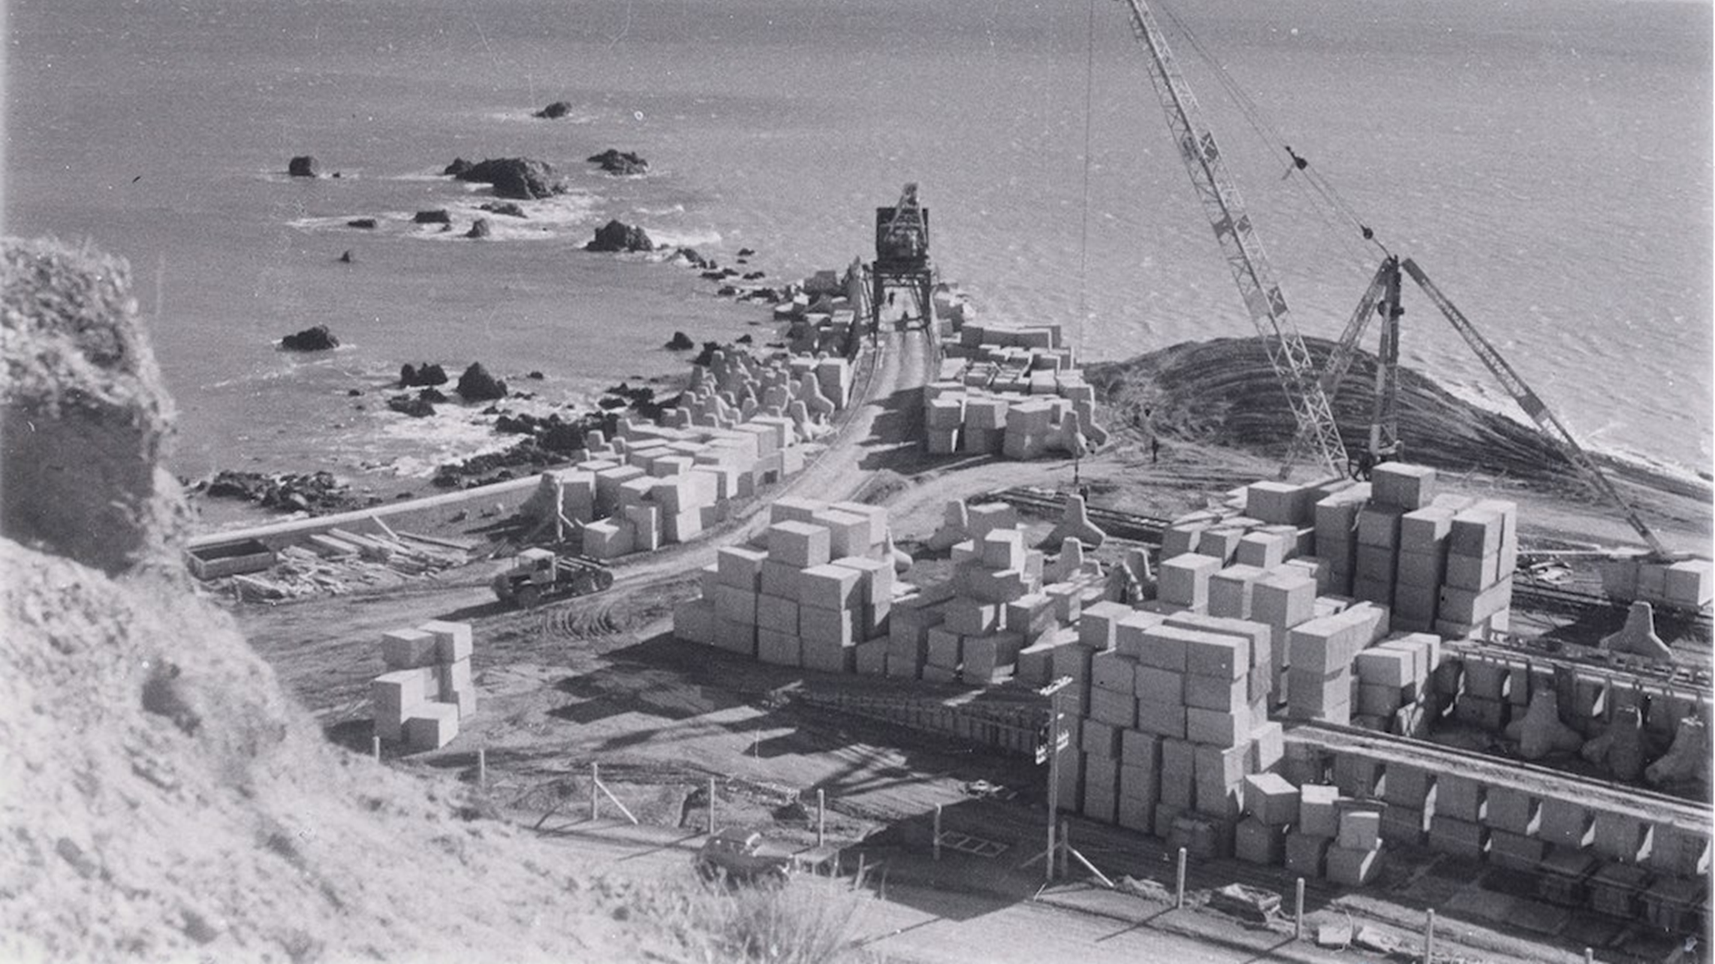
Breakwater Construction

Slide 5
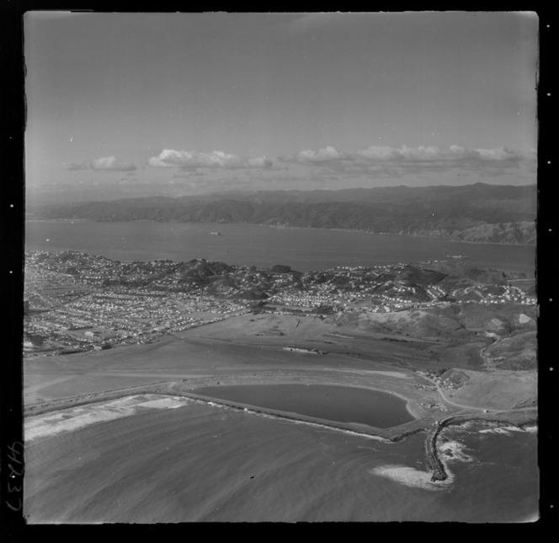
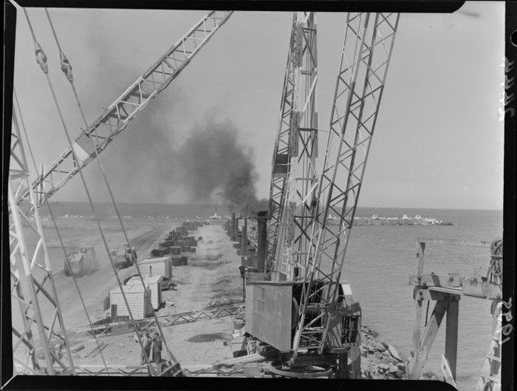
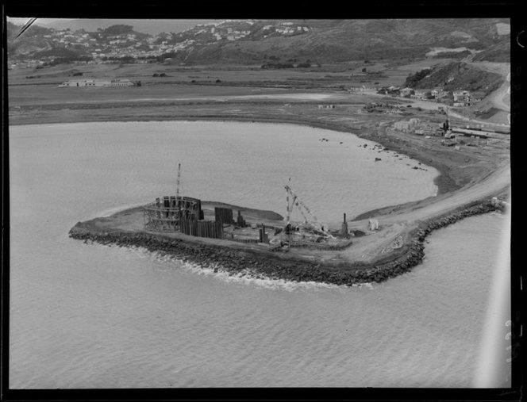
1950’s causeway construction

Slide 6
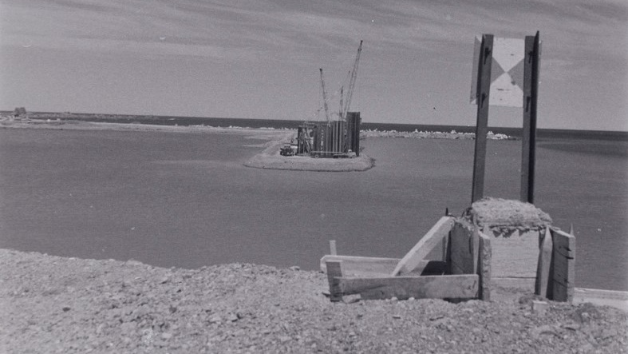
Causeway Construction
Moa Point Rd today

Slide 7
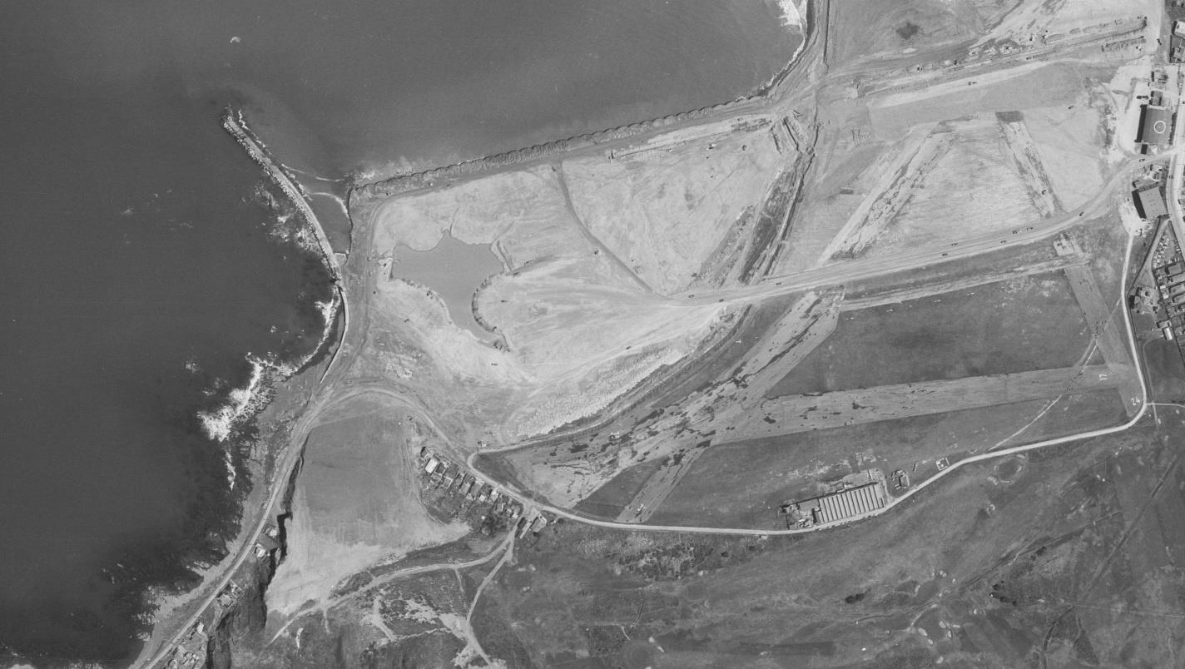
Runway Construction
18 Sept 1957

Slide 8
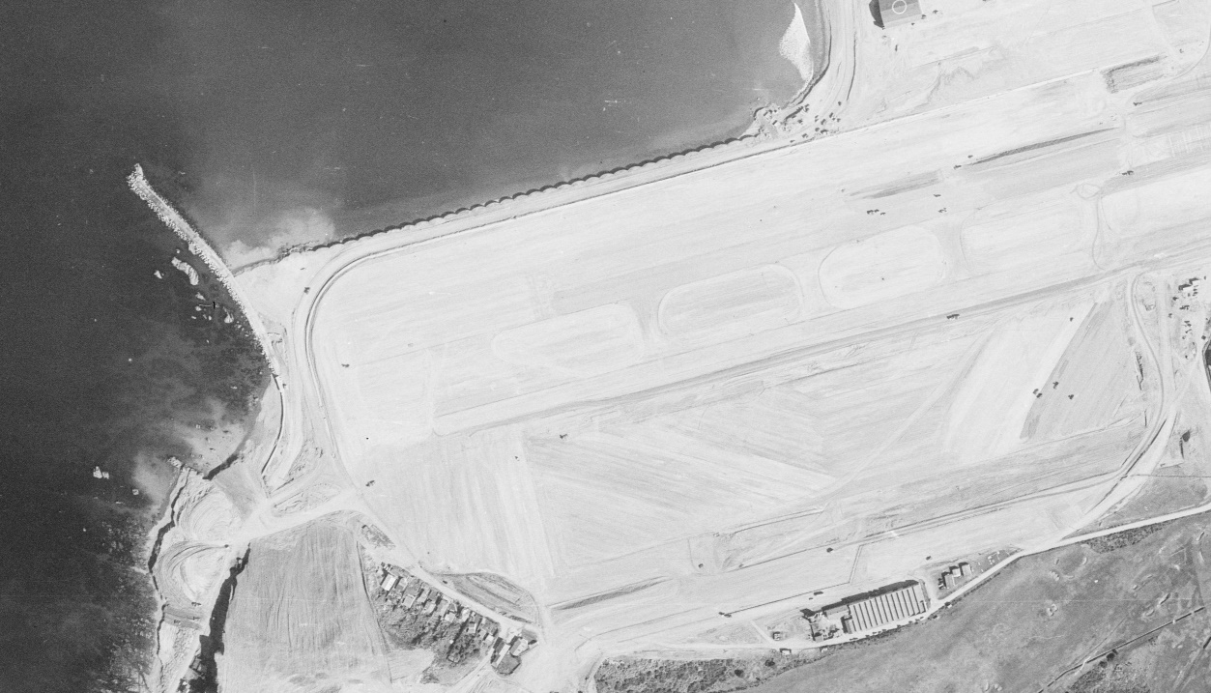
Runway Construction
8 Sept 1958

Slide 9
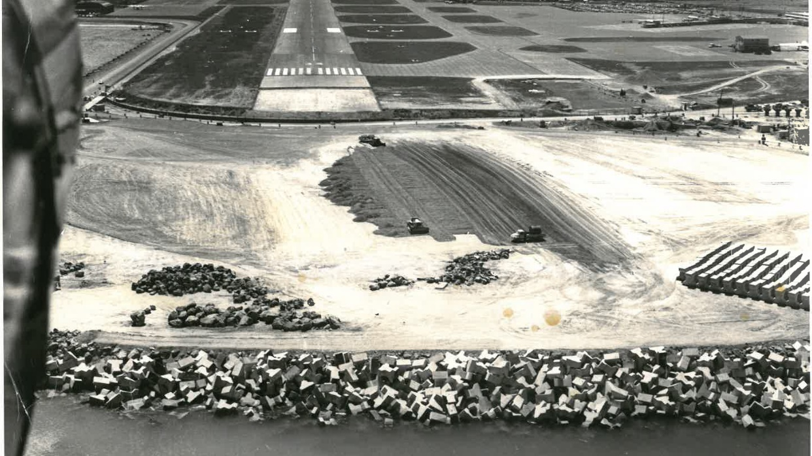
1972 Runway Extension

Slide 10
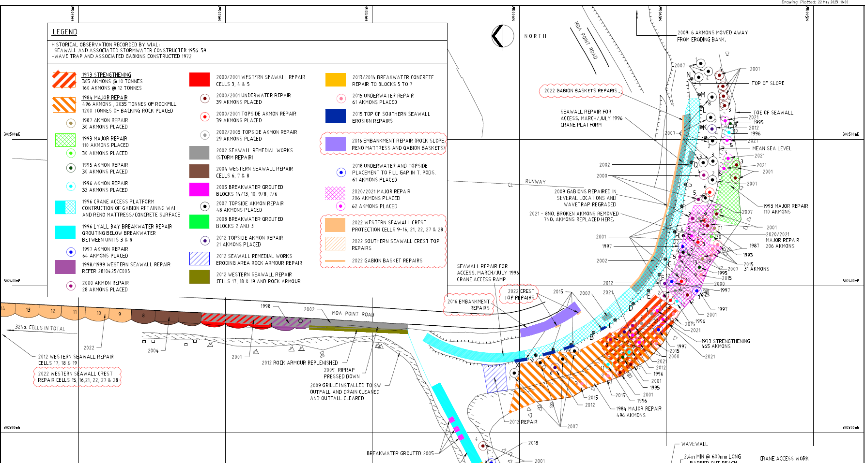
>> Wellington Airport Lyall Bay Marine Defences
21 September 2023

Slide 11
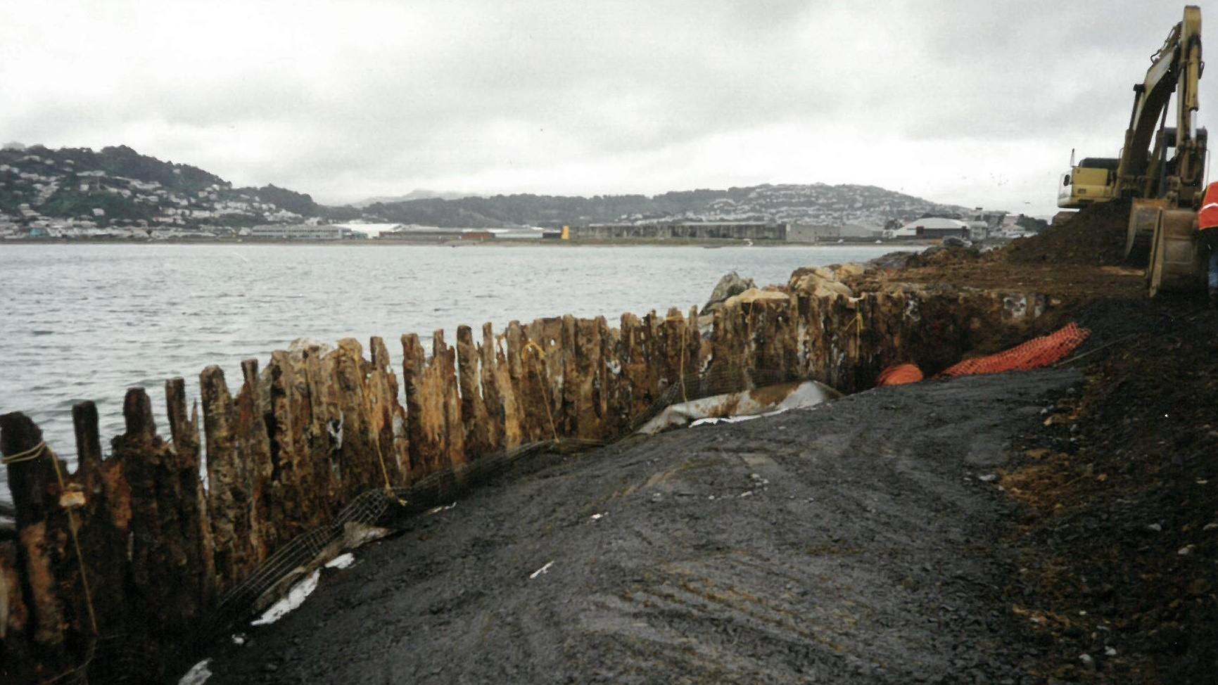
Condition of Western Sheetpile cells
>> Wellington Airport Lyall Bay Marine Defences

Slide 12
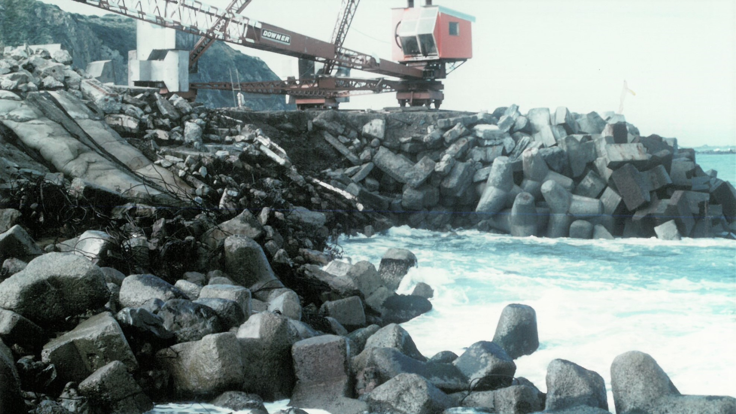
April 1984 Breach

Slide 13

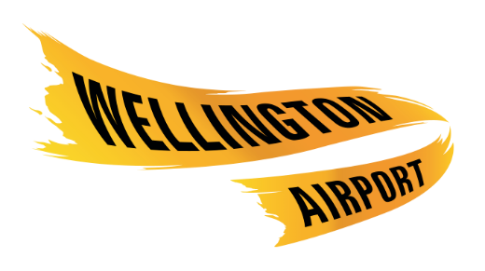
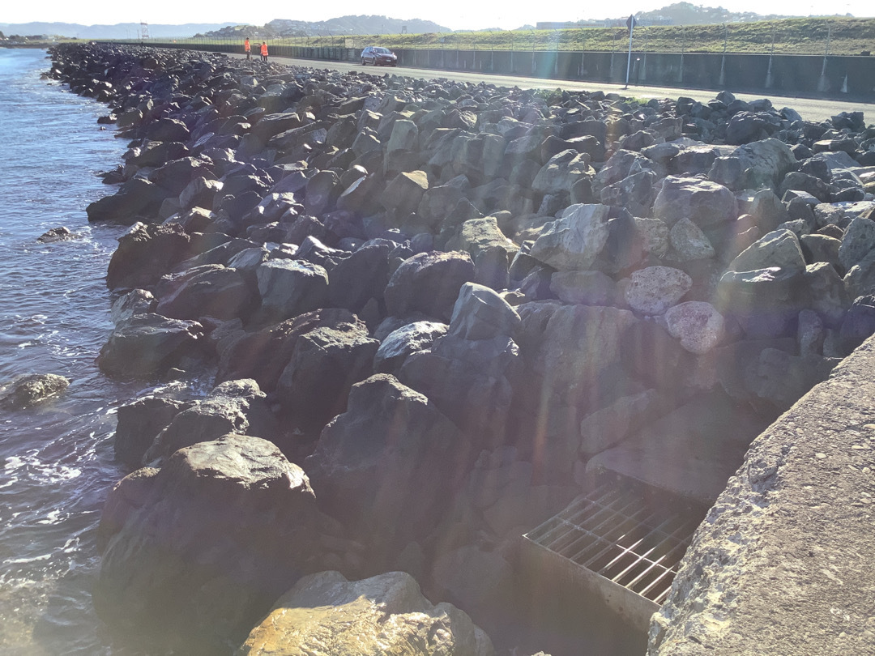
Wellington Airport
Project Overview
Strategic resilience project in WIAL’s 2040 Masterplan.
Objectives:
  Safeguard the long-term operation of Wellington Airport and adjacent council infrastructure against natural hazards, e.g., coastal inundation, coastal erosion.
  Provide for continued safe airport operation during the sea defences construction period.
  Deliver a sustainable solution that is adaptable for any future Wellington Airport development opportunity and delivers prudent use of capital.
Western Seawall

Slide 14
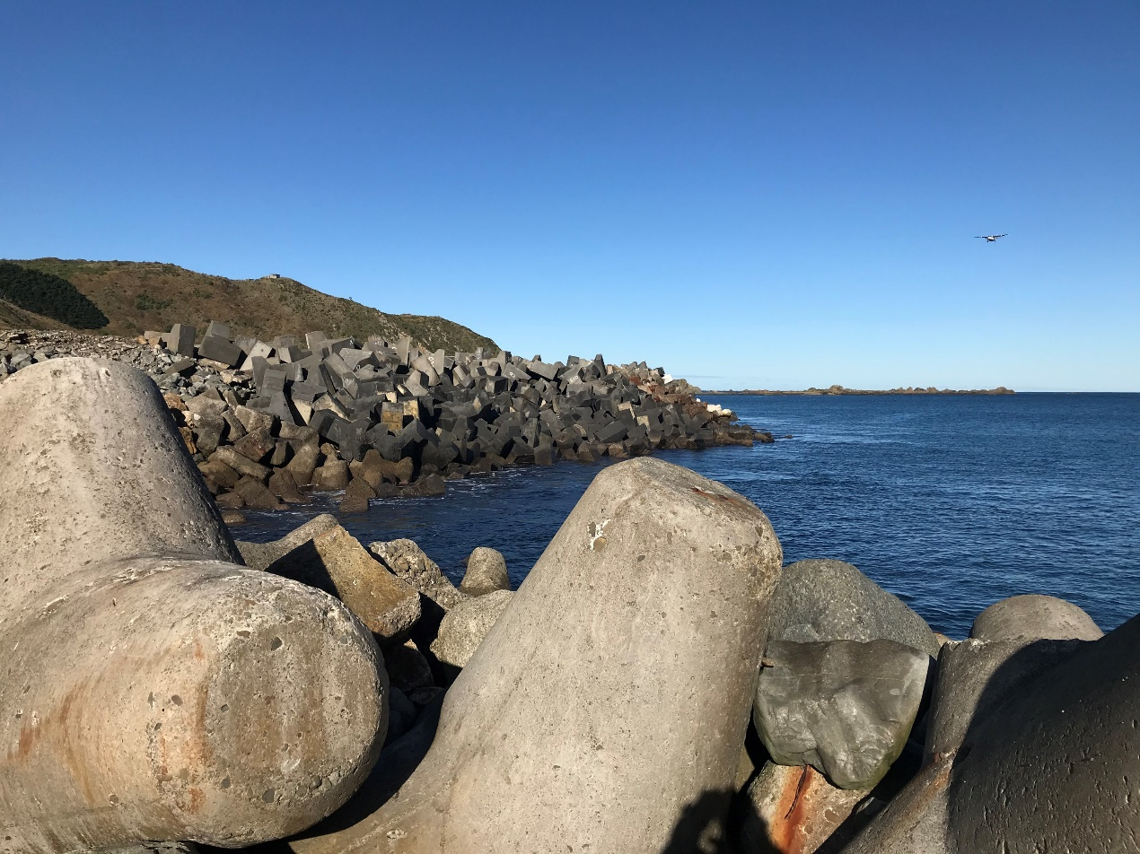
Wellington Airport
Site features
Operational environment:
  OLS (Obstacle Limitation Surface)
  ILS (Instrument Landing System) glide path
Wave, wind exposure
Shallow water by Lyall Bay Breakwater & Western Seawall
Moa Point Road traffic
Underground services
Underground services

Slide 15
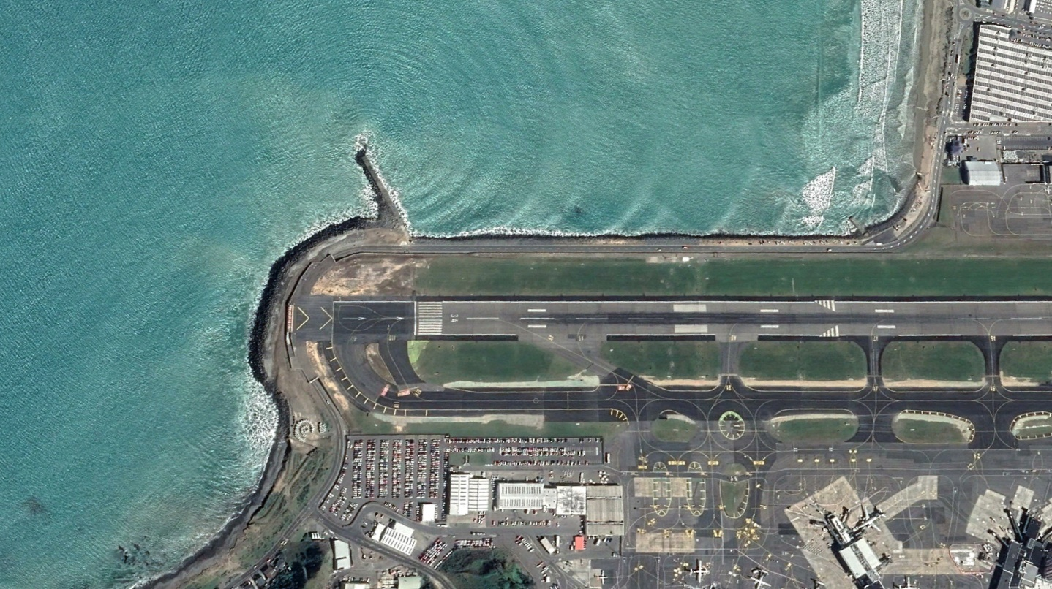
>> Wellington Airport Lyall Bay Marine Defences

Slide 16
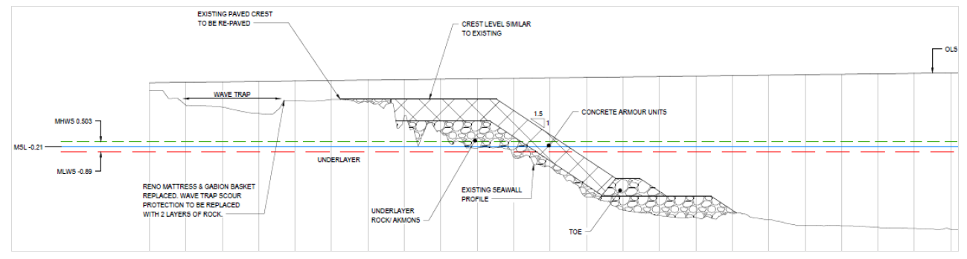
Wellington Airport
Southern Seawall options
Overlay option

Slide 17
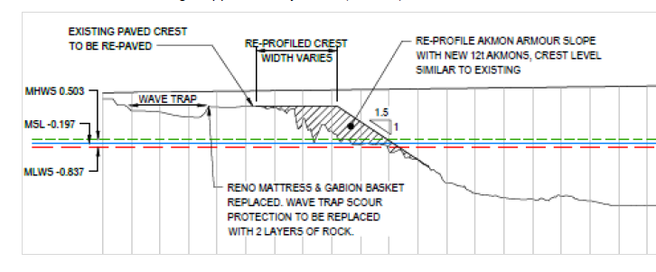
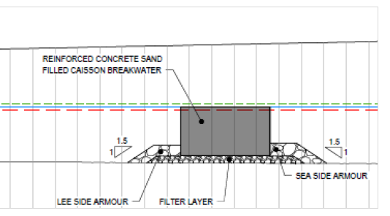
Wellington Airport
Southern Seawall options
Caisson option

Slide 18
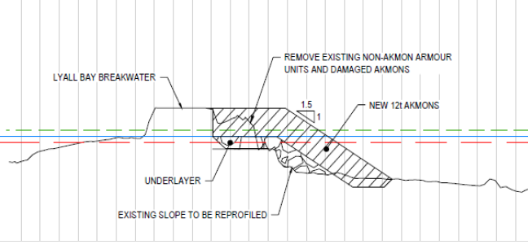
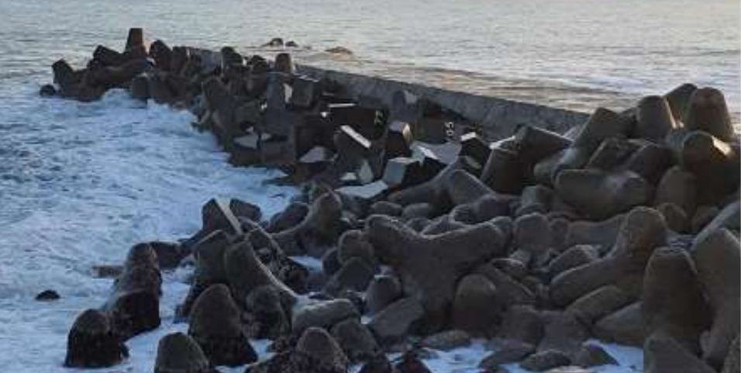
Wellington Airport
Lyall Bay Breakwater options
Repair and armour
Monitor and manage

Slide 19
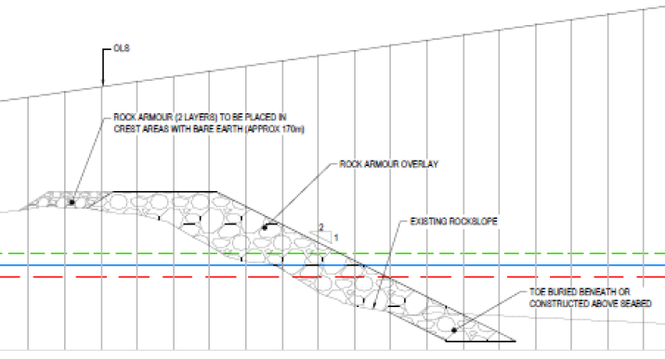
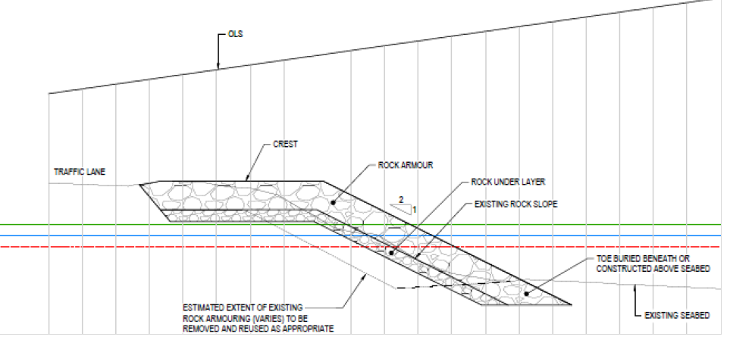
Wellington Airport
Western Seawall options
Rock overlay
Rebuild and armour (low crest)

Slide 20
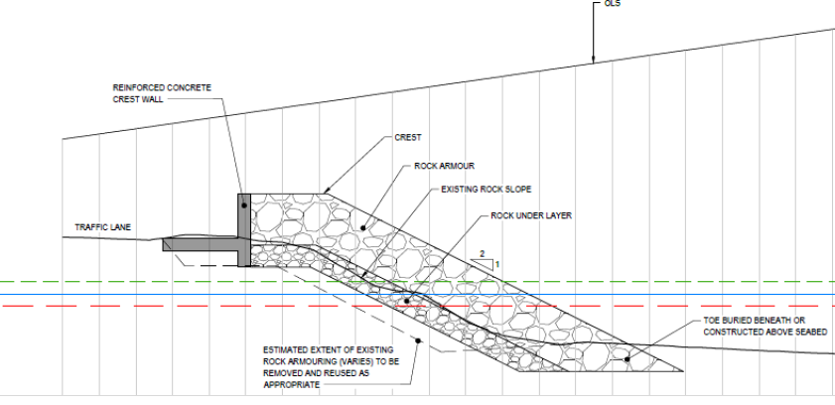
Wellington Airport
Western Seawall options
Rebuild and armour (high crest)

Slide 21
Wellington Airport
Community consultation and consenting – next steps
GWRC Natural Resources Plan (NRP) includes rules that provide for routine repair and maintenance of coastal defence structures – scale of proposed works will not meet permitted activity standards.
Resource consents will be required under NRP and WCC District Plan which will be open to public feedback.
Range of technical assessments will be required to assist the consenting process including ecology, landscape and natural character, coastal processes, heritage, cultural and recreational use assessments.
Construction related effects (noise, vibration, dust, transportation) will also require detailed assessment.
Technical assessments will be commissioned in October.

Slide 22
Wellington Airport
Community consultation and consenting – next steps
Wellington Airport is committed to engaging with community and key stakeholders, including mana whenua.
As technical work continues, this will be shared. Collaboration is key to getting community perspectives about the range of environmental effects that will likely occur and how best to manage them.
A key challenge is to address amenity related effects arising from construction activities, some of which need to occur after daily airport operations cease (i.e. at night) and which require the movement of construction materials, plant and machinery to and around the site.
How can we work together to best manage these effects?

Slide 23
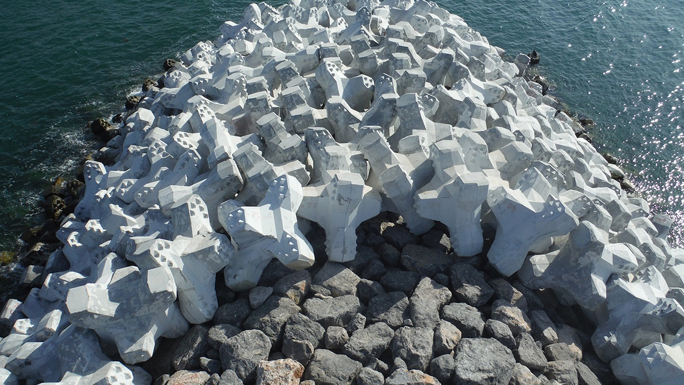
Questions?

